Slide 1
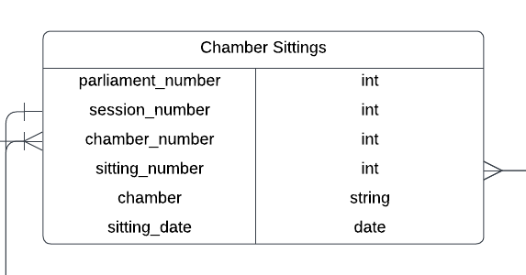
Chamber Sittings
1. parliament_number: No existing number in the current dataset. Require manual assignment using years and dates
2. session_number: We have it in Bills table!
3. chamber_number: Either “Commons” or “Lords,” represented by 1 and 2. Require manual assignment
4. sitting_number:we do not have it, and it seems extremely hard to find. My suggestion is to use date instead. As one sitting is strictly constrained within 1 day

Slide 2
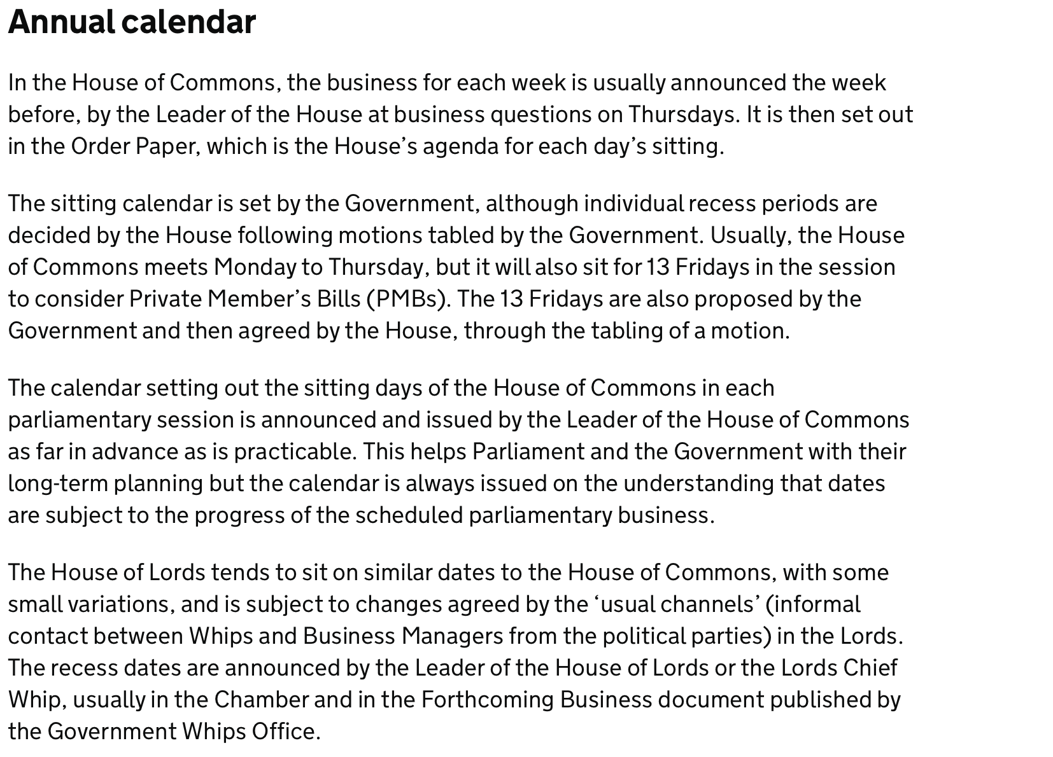
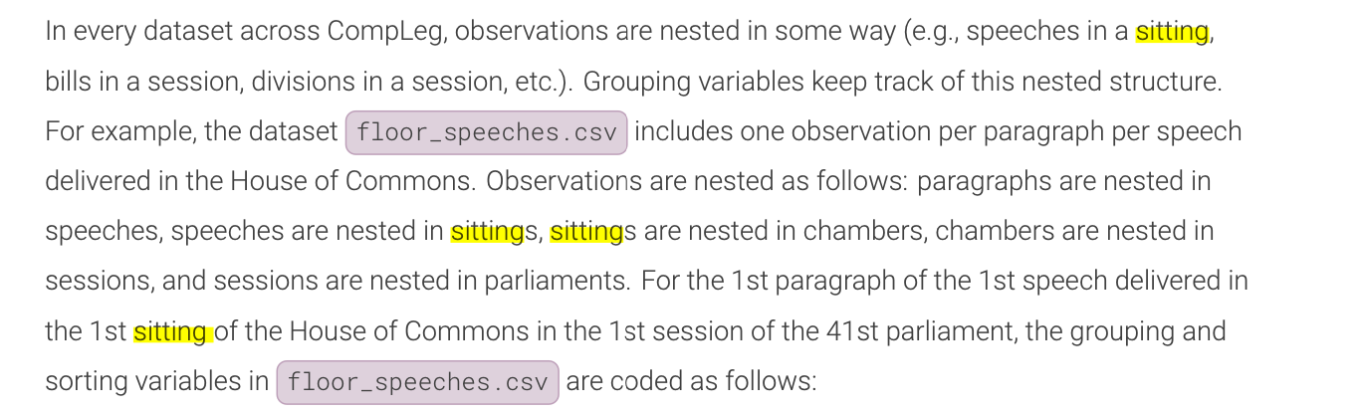
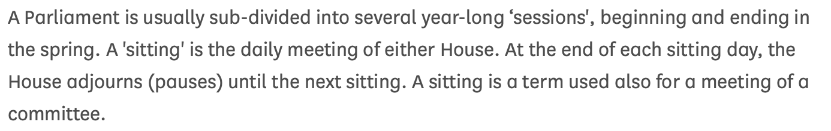
Understanding Sittings and Sessions

Slide 3
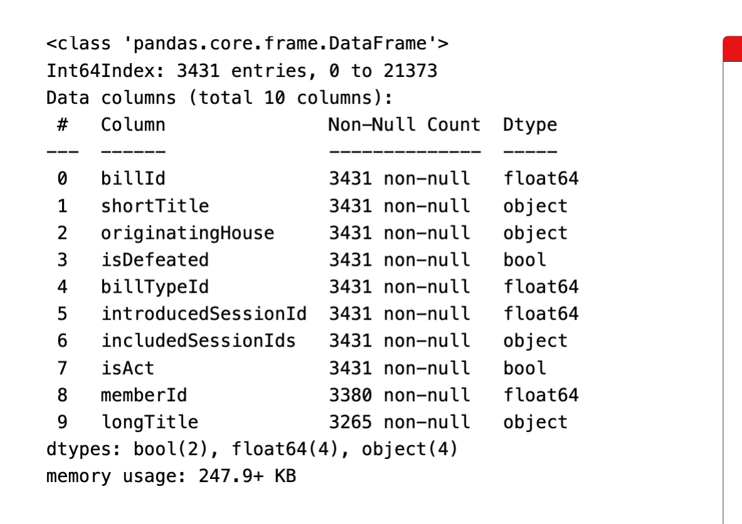
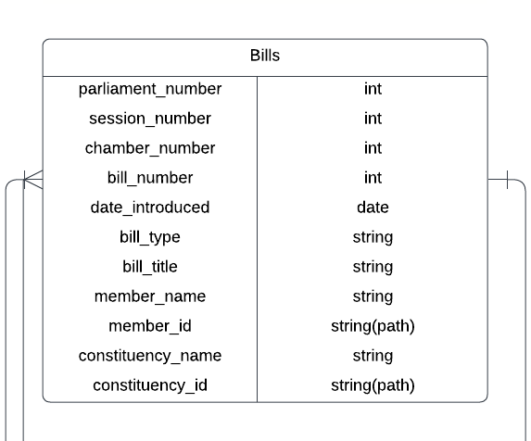
Bills
-Parliament number: missing and could be assigned
-Session number: I wonder why this is incorporated in here. I feel like it would be more suitable for Bill version. Or it could be asking for the session number when the bills are introduced -Chamber number: I understand this as the originating house which we have
-Bill_number: We have it! -Bill_title: short and long, we have them! -member_name: replace with member_id
-constituency_id: associated with member_id, no need for inclusion

Slide 4
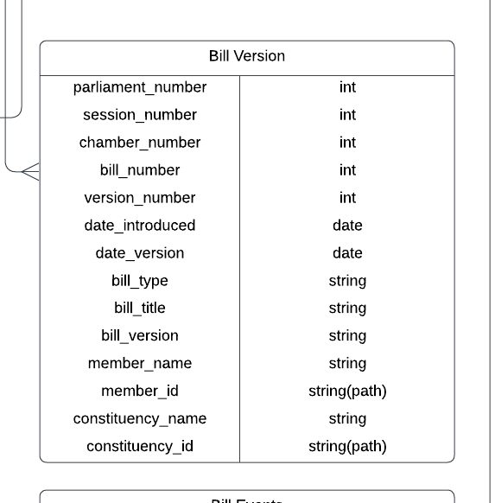
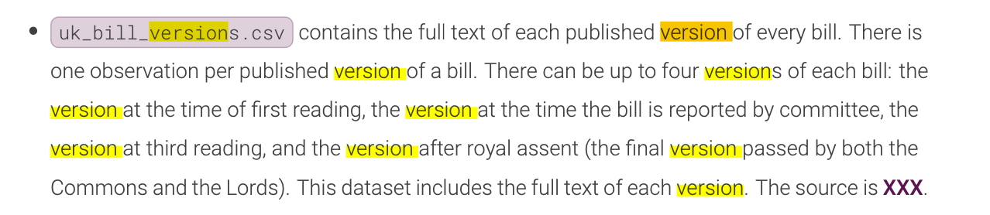
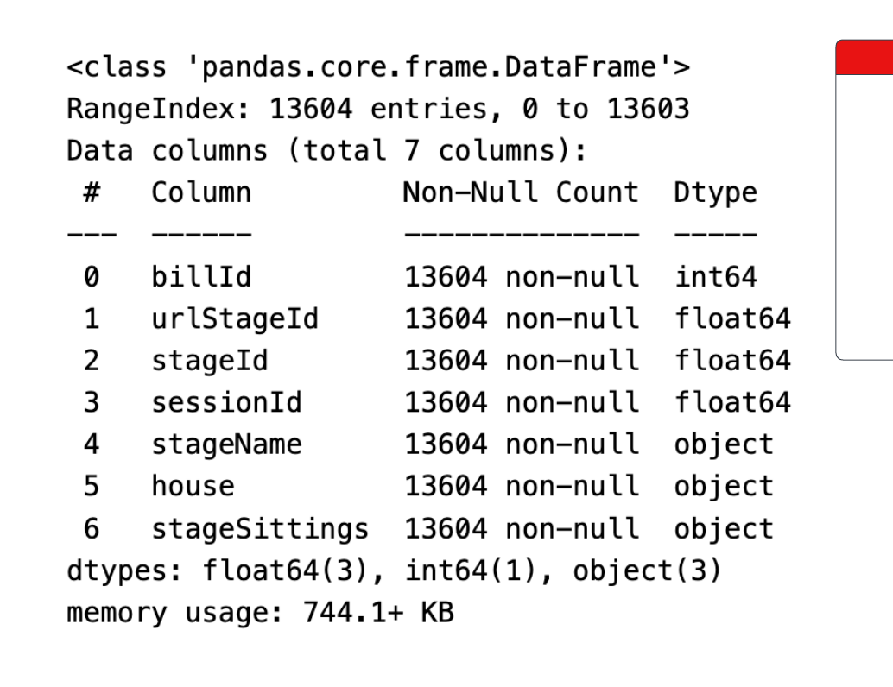
Bill Version
Download every single bill version in the format of full text?
Version number needs to be assigned?
Bill_version:
As amended by committee
As passed by the House of Commons
As passed by the House of Lords
First Reading
Royal Assent

Slide 5
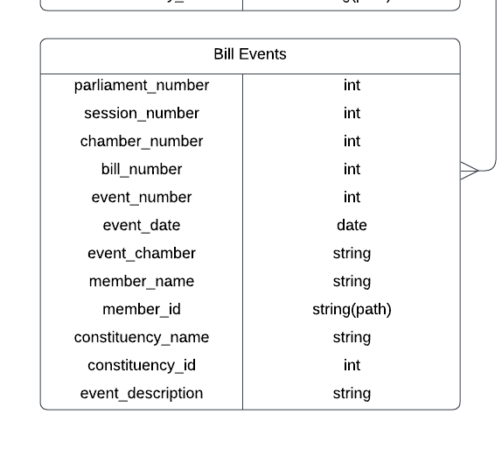
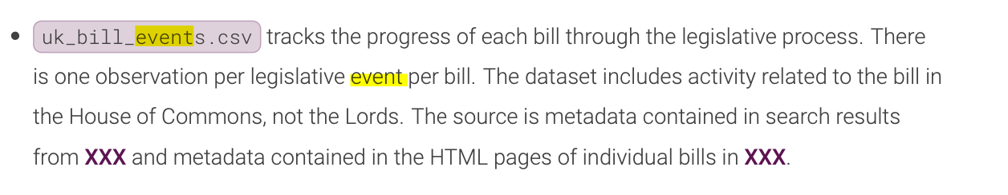
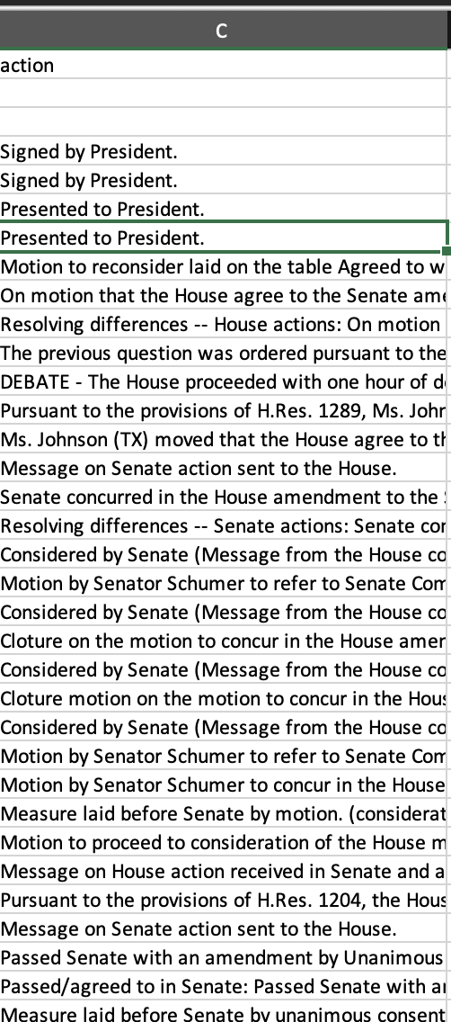
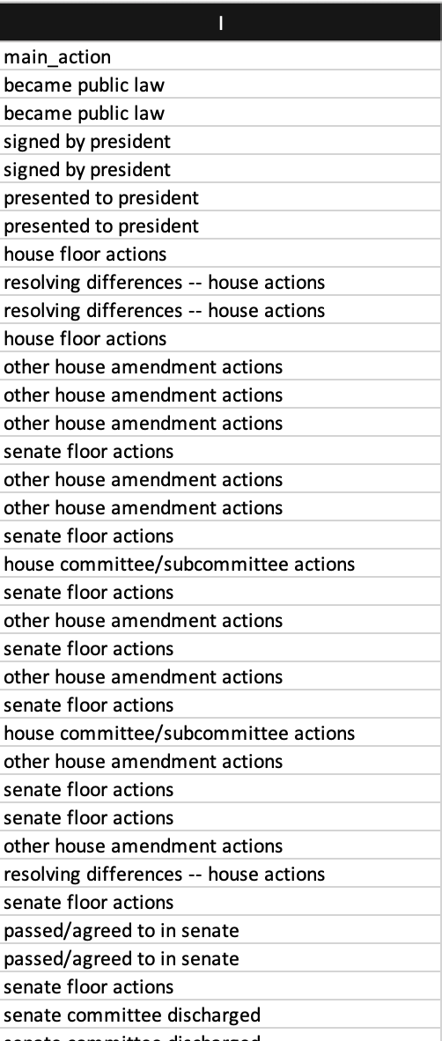

Bill Event
The event I could think of is the stages that a bill has gone through.
Unlike US Measure Action, the UK parliament website does not keep a record
As detailed as US Congress

Slide 6
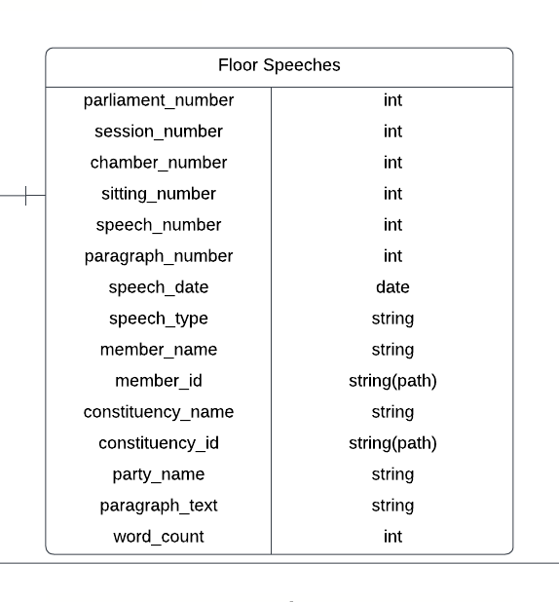
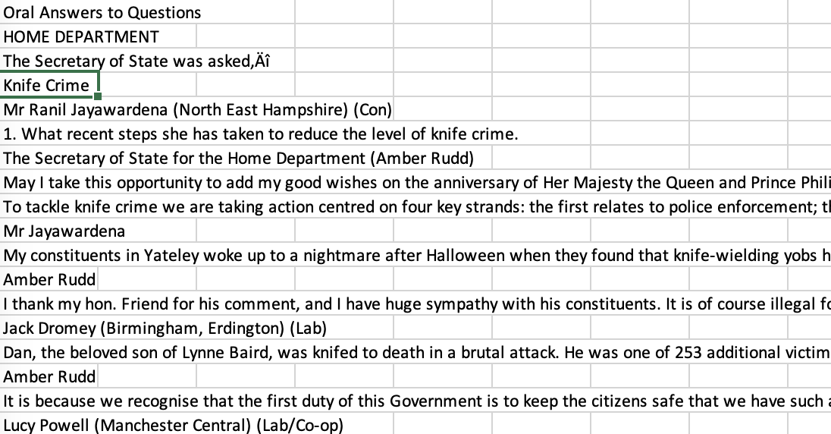
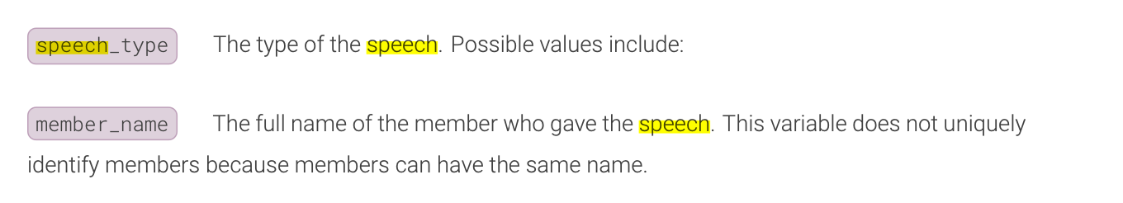
Oral Questions
Parliament_number: manual matching
Session_number: if it is really a year long division, then it should be easy to find out, and we can validate using the Bill sessions chamber_number: **
sitting_number: we do not have it, and it seems extremely hard to find. My suggestion is to use date instead. As one sitting is strictly constrained within 1 day speech_number: no source, assign index paragraph_number speech date: we have it in the txt files, needs extraction speech_type

Slide 7
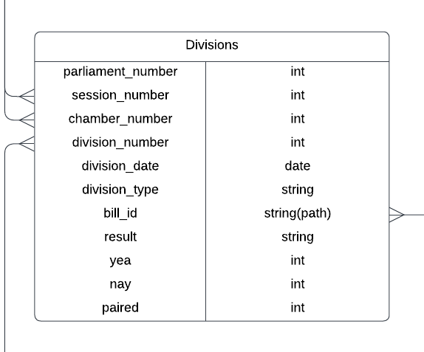
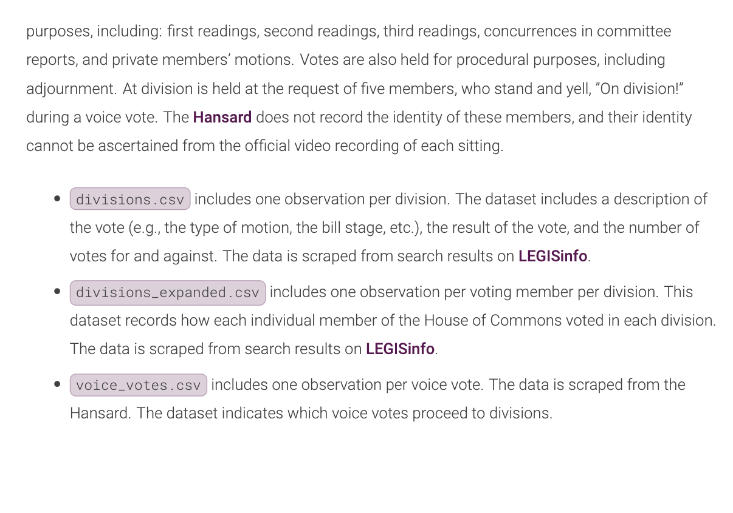
Common Division

Slide 8
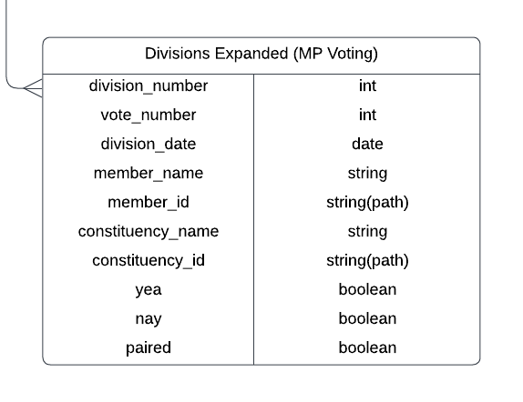
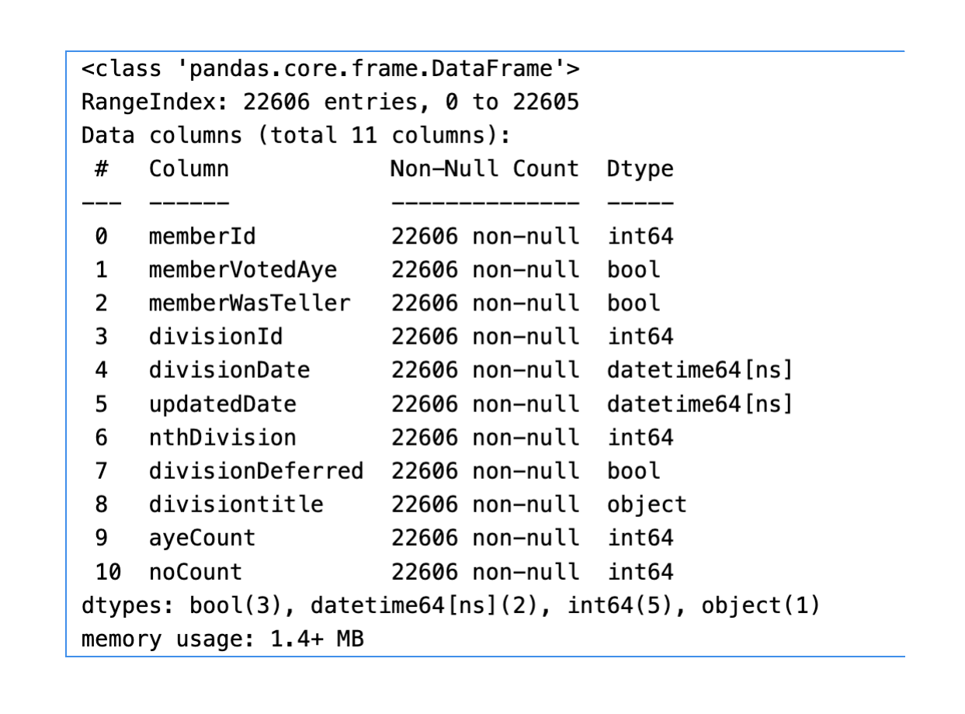
Common Division Member

